Slide 1
Azure Functions
The easy way to an API
Björn Sundling
Mastodon.nu/@bjompen
Notes:
https://learn.microsoft.com/en-us/azure/azure-functions/functions-reference-powershell

Slide 2
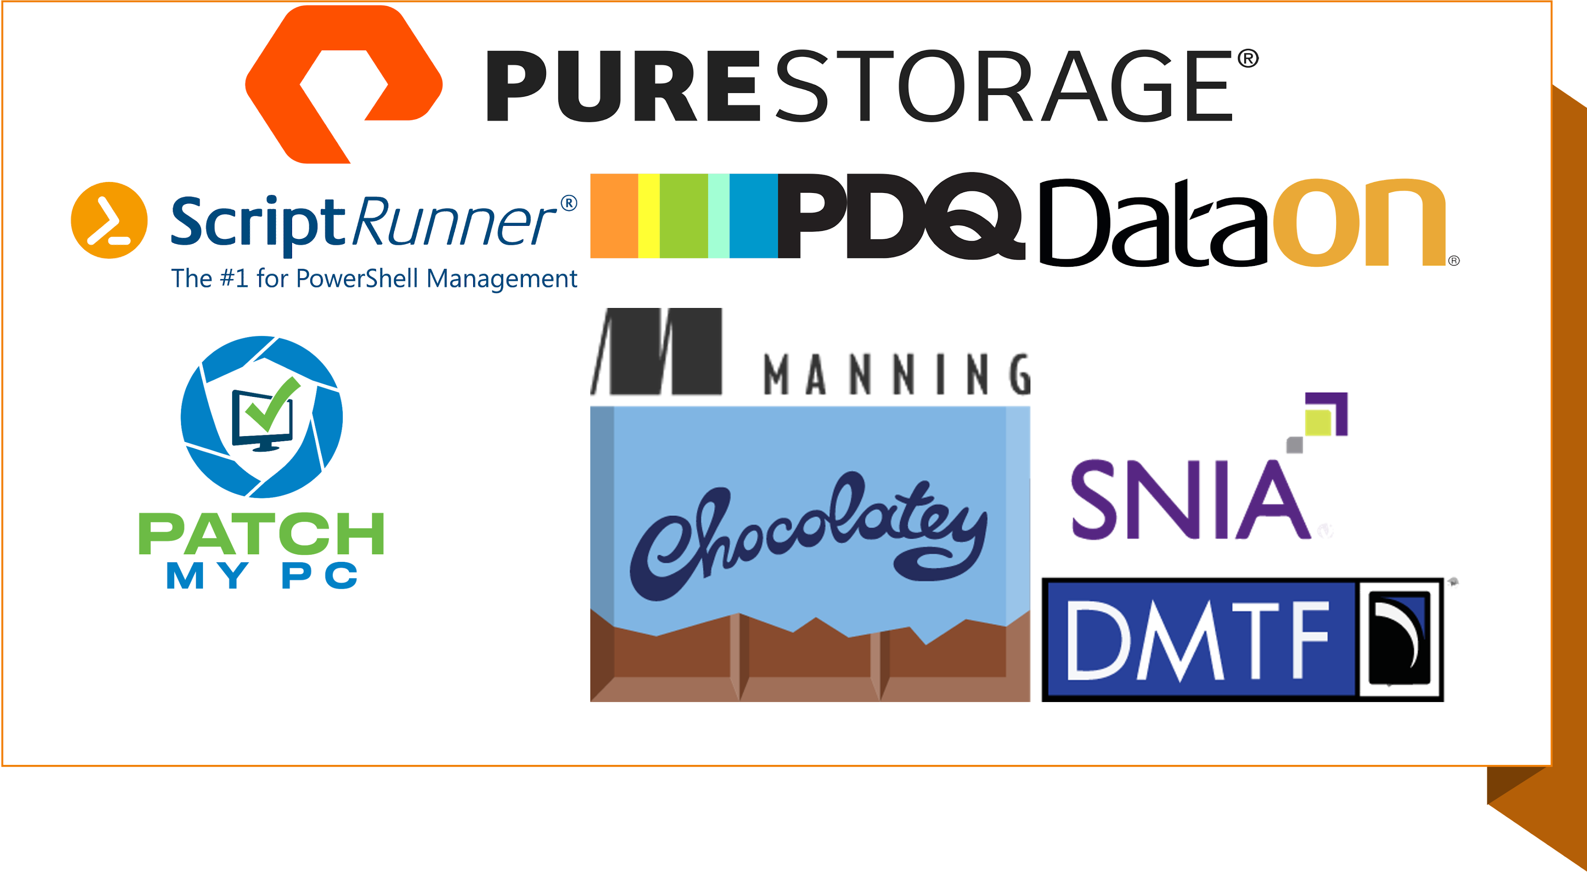

Slide 3
About me
Outernet
Björn “Bjompen” Sundling
MVP, MCT, and other titles…
DevOps and Azure consultant @ Advania Sweden
Internet
Mastodon.nu/@bjompen
Github.com/bjompen
Bjompen.com

Slide 4
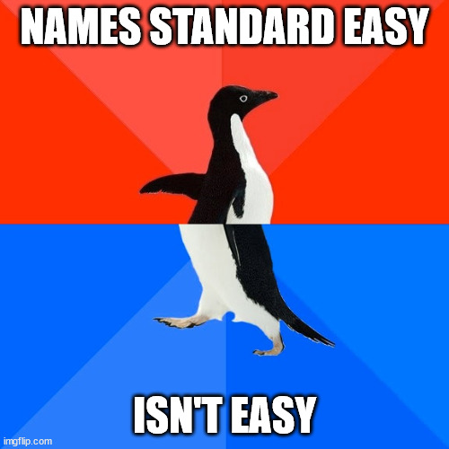
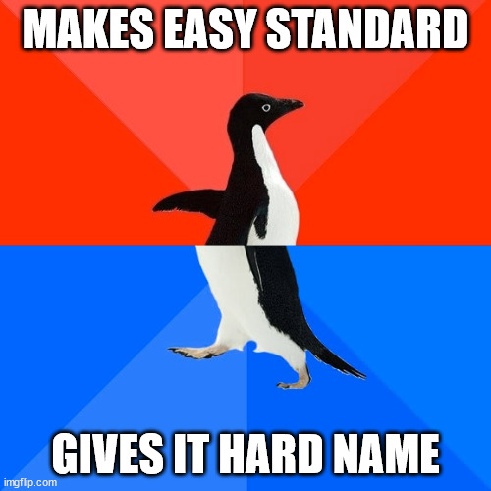
What is an API?
Application Programming Interface
Web API
SOAP, REST, Web 2.0, and other buzzwords
Reason? Hide the details.
Notes:
application programming interface
- In contrast to a user interface, which connects a computer to a person, an application programming interface connects computers or pieces of software to each other. It is not intended to be used directly by a person (the end user) other than a computer programmer who is incorporating it into the software
Interchangeably using WebAPI and API
WebAPI – Technically the same as any other API, but hosted on a web server.
Part of “web 2.0” – The early nougts buzzword.
SOAP (Simple Object Access Protocol)– Standard by W3C, use XML and validation. Not as simple as the name suggests
REST (representational state transfer) – Stateless, use HTTP, Follows HTTP methods (Get, Post, Patch, Put, and so on)
- Querystrings v.s Post bodies
RESTFul – Should be an API that adheres to the REST principles,
but has become a name for APIs JSON and not necessarily supports the full implementation.
Just as we don’t need to show the source of our modules, we don’t show the source of our API’s

Slide 5
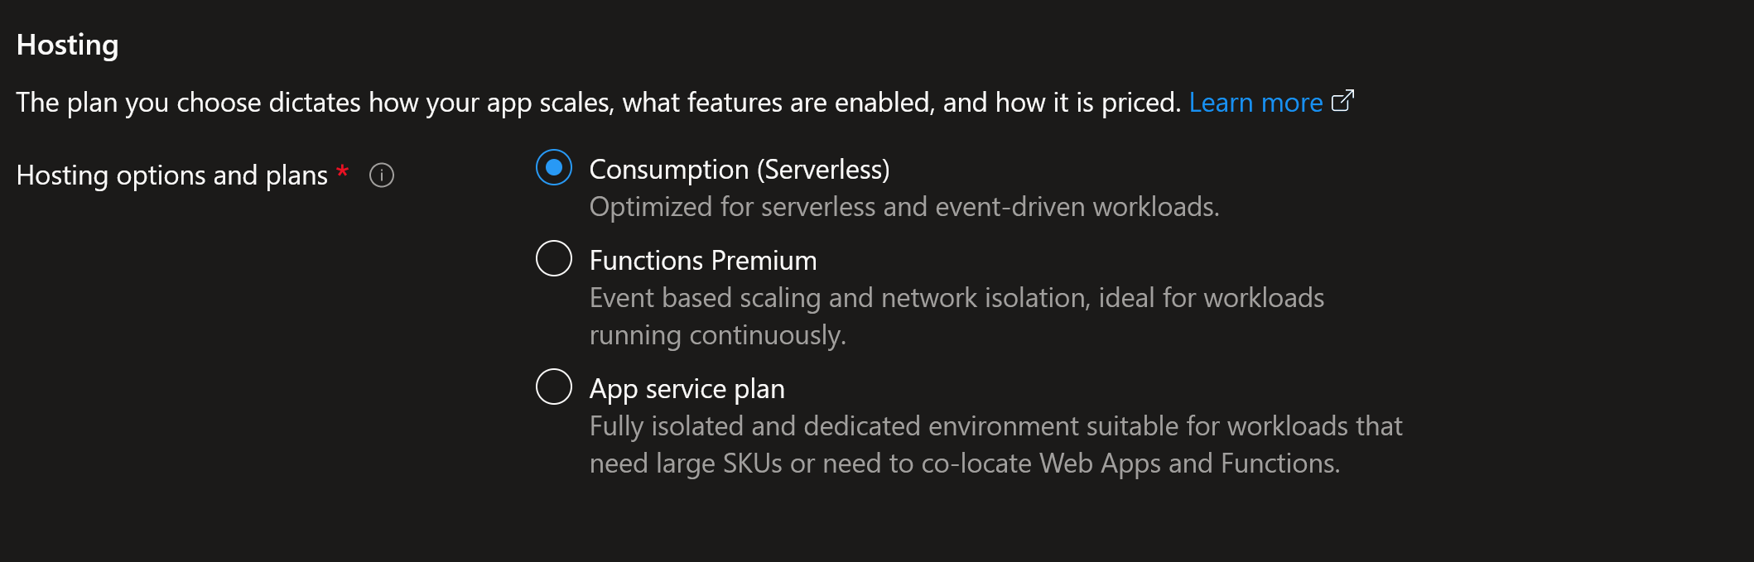
What is Azure functions?
Serverless (…) computing.
App service plan - Runtime host
Function App – Container runtime
Functions – Containers on a host
Notes:
Serverless. Not without server, you just don’t manage it.
“Here’s my code, just run it!”
Durable functions – Stateful, orchestrator keeps track of different runners. Output from one to another, fan out, and more.
App Service plan – Runtime Host - one host for all your functions.
Controls scaling. If you run consumption it’s pretty empty.
Function App
Controls your app settings , Networking, Custom domains, and more.
Comparable to a container host or a hyper visor?
Functions – Runs containers on your machine.
Service plan variants
Consumption – Pay for what you use. New VM every time.
Premium – More functionality – No cold starts, Private networking!
Dedicated (App Service Plan) – Your own machine.
AKS / Kubernetes – I don’t know
Demo: Visa GUI
- App service plan – Y1 is consumption – no features
- Apps -> go in to function app
- Managed identity, custom domains, console (advanced tooling)
- Settings -> Configuration
- Overview –> Functions (multiple in one machine)

Slide 6
Azure function infrastructure
Setting it up using GUI 🤢
Setting it up using PowerShell 🤔
Setting it up using Bicep 💞
Notes:
{
name: 'WEBSITE_CONTENTSHARE'
value: toLower(functionAppName)
}
This is buggy, Remove from your deployment code for pipelines.

Slide 7
Developing functions - Tooling
Func – the funky CLI
VSCode
Plugins
Connect to Azure
Create function
Useless and useful files…
Notes:
Azure functions core tools – func – lets you run functions locally as if they were published.
https://github.com/Azure/azure-functions-core-tools
VSCode – Azure Functions plugin
https://marketplace.visualstudio.com/items?itemName=ms-azuretools.vscode-azurefunctions
In VSCode – F1 -> azure: sign in
Create New project – All files, will ask to overwrite
Create function – Creates all files if needed, only function otherwise
Azure extension -> Azure functions -> Create function ->
- Use(less?) files
- .vscode – without it VSCode will complain about initializing. It is not needed for the function. Don’t deploy, but keep
Only needed if you are running stuff locally. All cloud? Delete.
- .funcignore – If you use func cli to deploy, this tells it to ignore files or folders. Like .gitignore for function deploys
- local.settings.json – If you use func cli this contains local app settings and configurations
- In trigger/run.ps1 folder – Sample.dat – Control test scenarions of GUI stuff. I have never used it, nor found anyone else who has.

Slide 8
Developing functions – The code
Input bindings vs. triggers
Start a job or play with data from a source
Output bindings
Data to caller or data to service?
HTTP Status codes and why they matter
GET, POST, and other methods
Notes:
Input bindings – Gets data from a source
Triggers – Starts a job.
Can be mixed and matched – f.eg
- Trigger on HTTP get
- Use query parameter to set a value
- Use SQL input binding to run SQL cmd and fetch data based on query value.
Output bindings
- Some accept single values, some multiple
- Use HTTP response as status code if you use HTTP trigger, even if you output to other resources.
[System.Enum]::GetNames('System.Net.HttpStatusCode') | %{"$_`t$([System.Net.HttpStatusCode]::$_.value__)"}
Write-*
- data to log, can be read in GUI (Log Stream in function app) or forwarded to logstash/log analytics
- log level is mapped to PowerShell streams: Error, Warning, Information, Debug, Trace.
- Also needs to add logging.loglevel setting in hosts.json to display logs! - https://learn.microsoft.com/en-us/azure/azure-functions/functions-reference-powershell?tabs=portal#configure-the-function-app-log-level
**DEMO**
https://learn.microsoft.com/en-us/azure/azure-functions/functions-reference-powershell?tabs=portal#triggermetadata-parameter
https://learn.microsoft.com/en-us/azure/azure-functions/functions-reference-powershell?tabs=portal#request-object

Slide 9
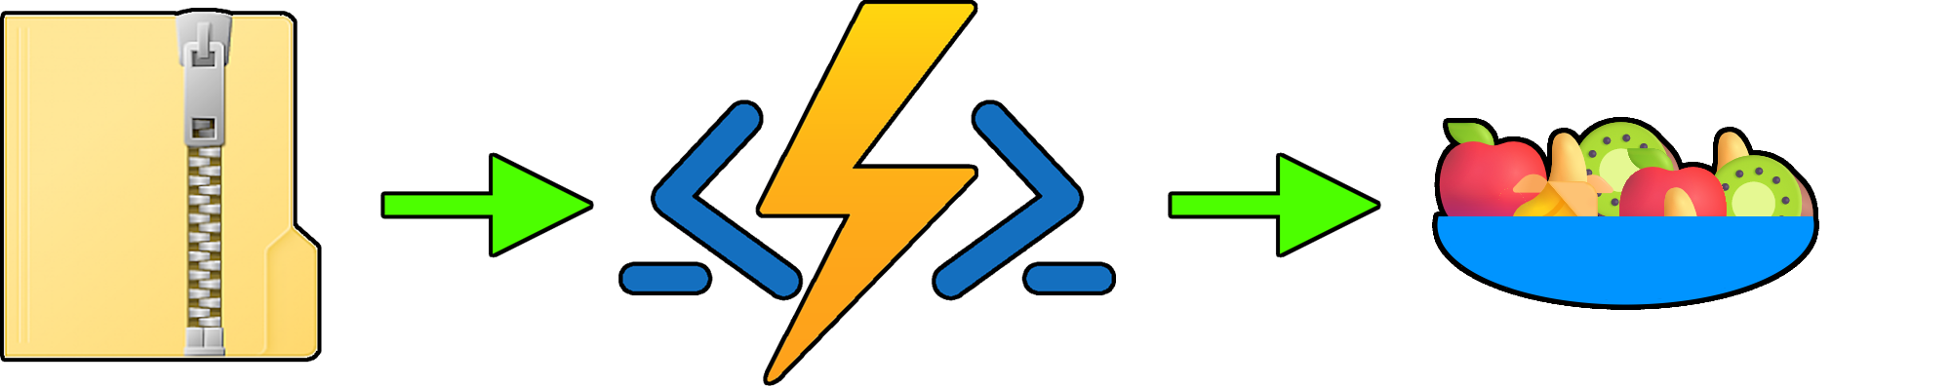
Developing functions - Deploying
Notes:
Azure -> resources -> subscription -> function app -> right click -> deploy
Go to “output” in console of VSCode to show what happens
Actually zips my entire folder to a zip file
az functionapp deployment source config-zip
Logs in portal
Advanced Tools (Go to KUDU) -> Deployments
You can also see other cool stuff in kudu, such as files. If you deploy doesn’t work, this is where you can really dig in to details

Slide 10
Automation, DevOps, and CI/CD
Deployment center
Pipeline deployments
Tasks vs. Script
Notes:
Function app -> deployment center
- Creates a PAT to set stuff up
- Creates a web hook to the selected repo
- The magic is in Azure – A.K.A no idea what goes on.

Slide 11


Questions?
Mastodon.nu/@bjompen
Github.com/bjompen
Bjompen.com

Slide 12

THANK YOU
Please review this session

